Slide 1
Computer Principles for Programmers
Preview of course topics and looking into the ICT News

Slide 2
News of the Week – readable slide
ICT NEWS
CBC Tech Spark
Globe and Mail Tech
WWW Foundation
Mozilla internet citizen
MIT Tech Review
IT World Canada
IT business
Techmeme
Slashdot
XKCD
NYT tech
NYT newsletter
Notes:
Google: ict news canada, it news websites
https://webfoundation.org/ The World Wide Web Foundation was established in 2009 by web inventor Sir Tim Berners-Lee to advance the open web as a public good and a basic right.
https://blog.mozilla.org/ We make the internet safer, healthier and faster for good. Mozilla is the not-for-profit behind Firefox, the original alternative browser. We create products and policy to keep the internet in service of people, not profit.
https://www.technologyreview.com/
http://www.itworldcanada.com/
http://www.itworld.com/
http://www.computerweekly.com/
http://www.computerworld.com/
https://www.nytimes.com/section/technology may require access through the Seneca library.
Get the NYT tech newsletter in your inbox every weekday; sign up at https://www.nytimes.com/newsletters/signup/OT
Techmeme - http://www.techmeme.com (aggregator with human editing)
Slashdot - http://slashdot.org/ (aggregator with human editing)
https://www.huffingtonpost.com/section/technology
Ars Technica - http://arstechnica.com/
https://www.theguardian.com/uk/technology
Technowize - https://www.technowize.com/
CNET - http://www.cnet.com/ ( -ZDNethttp://www.zdnet.com/ )
Digital Trends - http://www.digitaltrends.com
Engadget - http://www.engadget.com/
GigaOM - http://gigaom.com/
Gizmodo - http://gizmodo.com/
Mashable - http://mashable.com/
ReadWrite - http://www.readwrite.com
The Next Web - http://thenextweb.com/
The Verge - http://www.theverge.com/
TechCrunch - http://techcrunch.com/
TechRadar - http://www.techradar.com/

Slide 3
News of the Week – unreadable slide
Google: ICT NEWS
https://www.quora.com/What-are-the-best-sources-for-tech-news
http://www.itworldcanada.com/
http://www.itworld.com/
http://www.computerweekly.com/
http://www.computerworld.com/
https://blog.mozilla.org/internetcitizen/
http://www.wired.com/
News Aggregators
Techmeme - http://www.techmeme.com (with human editing)
Slashdot - http://slashdot.org/ (with human editing)
YC Hacker News - http://news.ycombinator.com (with voting)
Hacker News - http://hackernews.org/ (rss feeds)
News Sources
CBC Tech Spark Globe and Mail Tech
WWW Foundation Mozilla internet citizen
MIT Tech Review
Ars Technica - http://arstechnica.com/
CNET - http://www.cnet.com/ ZDNet - http://www.zdnet.com/
Digital Trends - http://www.digitaltrends.com
Engadget - http://www.engadget.com/
Guardian – International USA
GigaOM - http://gigaom.com/
Gizmodo - http://gizmodo.com/
HuffPost - https://www.huffingtonpost.com/...
Mashable - http://mashable.com/
ReadWrite - http://www.readwrite.com
The Next Web - http://thenextweb.com/
The Verge - http://www.theverge.com/
TechCrunch - http://techcrunch.com/
TechRadar - http://www.techradar.com/
Technowize - https://www.technowize.com/
Notes:
Google: ict news canada, it news websites
https://webfoundation.org/ The World Wide Web Foundation was established in 2009 by web inventor Sir Tim Berners-Lee to advance the open web as a public good and a basic right.
https://blog.mozilla.org/ We make the internet safer, healthier and faster for good. Mozilla is the not-for-profit behind Firefox, the original alternative browser. We create products and policy to keep the internet in service of people, not profit.

Slide 4
Lecture Agenda and Activity
Overview and sampling of course topics.
This week's activity is to
Think about your professional destination
Investigate the News
Next week's quiz includes concepts and definitions found in these slides.
Notes:
Overview and sampling of course topics.
Intended to help get you started with topics the News
News items do not have to relate to course topics
Quiz questions ask about terms and information on the textually dense slides.

Slide 5
"Computers themselves, and software yet to be developed, will revolutionize the way we learn." --- Steve Jobs, 1 Feb 1985 interview
It has changed who we learn from (Youtube), where we learn (anywhere), what we learn might not , but the way we learn, the how and why we learn? Don't confuse the medium for the message.
Notes:
Class discussion. Computers and software and networks have changed a lot in 35 years. Have people changed in the last 3 decades? People’s behavior has changed. People used to talk to each other.
But have people themselves changed? Has the process of learning changed? Has technology revolutionized, i.e. fundamentally changed, your educational life?
More quantity of information, sure. Yes, much easier access to information. But assessing the quality of information now takes extra effort. You are now the editors, fact checkers, and evaluators of what you read; newspapers, magazines, journals, and textbooks had professional authors, editors, and publishers. Critical thinking skills are more important than ever in a social media environment that provokes and feeds off emotion.
What technology was being referenced in this tech revolution? It will produce forgetfulness in the minds of those who learn to use it, their trust in technology will discourage the use of their own memory. This is not an invention for learning but of reminding; it offers students the appearance of wisdom, for they will read, see, and hear many things without being properly taught. And they will be difficult to get along with, since they will merely appear to be wise instead of really being so. … that quote was paraphrased from The Phaedrus by Plato in 370 BC. Socrates was criticizing the invention of writing. Ironically, Plato wrote that down. Socrates came from an oral tradition where the value of memory didn’t just mean remembering but evaluating, understanding, and gaining wisdom. Memory meant more to him than coming home with everything on the grocery list.
But reading and writing skills took a long time to catch on: it was like programming today – hard to do – full of symbols, syntax, punctuation, rules; it was written in Greek, and later Latin; few had the skill to put abstract ideas into the meaningful code we call sentences, paragraphs, chapters, and books. Literacy has a very long history but it was a long time coming to the masses.
This feeling of technology being revolutionary and ruining everything has been going on, probably since, the invention of the wheel.
Sure, that wheel thing you invented is a nice bit of tech but a wheel is not much good without adding more tech like a cart. What are you going to do when the thing breaks a long way from home? You know those things break all the time. Yeah, you can transport loads twice as heavy as mine but with double the effort and at half my speed. You have to push an empty cart home. So, how much efficiency are you gaining overall? How is that cart load going to get up the hill? Heck, you get tired just pushing it around on the flat. I just put my bundle down when I need a rest. If you let go, the cart will roll away and crash at the bottom. How are you going to cross the deep stream – I can hold my bundle over my head…can you hold that cart over your head? Do stone wheels float? And what about the soft marshy ground near the stream where the wheel will get stuck in the muck? No, You can't use the bridge we built over the river, it's too narrow for your cart and it's not strong enough to bear that much weight concentrated in one spot. That wheel is not going to glide over rough ground, you're going to have to go round the things I just step over. And your muscles will atrophy – you'll never be able to carry a big bundle again. Really? A donkey? You're gonna train a donkey to pull the cart? Now you've got to keep a donkey happy. And build a barn for the donkey. Soon, you'll be expecting a vast infrastructure of roads and bridges, traffic laws, and satellite navigation to sort out the confusion. Pffft. Listen pal, you're just going to go round and round with that wheel thing.
When did the Information revolution start? With "Writing" as Socrates said in 370BCE? With Google, Wikipedia, the Internet?
"A respected Swiss scientist, Conrad Gessner, might have been the first to raise the alarm about the effects of information overload. He described how the modern world overwhelmed people with data and that this overabundance was both 'confusing and harmful' to the mind. … Gessner died in 1565." He was talking about the new technology of books being widely available over the past 100 years. In the 16th century, printing presses spread widely through Europe producing an estimated 150 to 200 million volumes. Imagine the impact! No wonder Herr Gessner died. http://www.slate.com/articles/health_and_science/science/2010/02/dont_touch_that_dial.html _* OR *_
https://slate.com/technology/2010/02/a-history-of-media-technology-scares-from-the-printing-press-to-facebook.html
What we now call the Internet – a mechanism of disseminating information – has been going on for about 500 years. A lot of it started with Gutenberg and his invention of movable type and printing technology in 1450. In the 16th C, reading became the new skill to have. Scholars and priests worried people would no longer go to universities or to church because they could stay home and read for themselves. Scholars and priests were even more worried that people would not know how to think about and interpret what they read.
In Renaissance Europe, the arrival of mechanical movable type printing introduced the era of mass communication, which permanently altered the structure of society. The relatively unrestricted circulation of information and revolutionary ideas transcended borders, captured the imagination of the masses during the Reformation and threatened the power of political and religious authorities. The sharp increase in literacy broke the monopoly of the church and the literate elite who ruled the lives of many and bolstered the emerging middle class. (https://en.wikipedia.org/wiki/Johannes_Gutenberg)
And there were vastly more pamphlets than books. Pamphlets – small, inexpensive, uncensored, unsanctioned, unorthodox booklets – were the Internet of the 16th C to 19th C. (Coming from a Latin word, "pamphlet" literally means "small book." https://www.britannica.com/topic/pamphlet) The pamphlet was the 16th C web page: it was easily created and distributed. Internet flame wars are not new; 500 years ago, there were pamphlet wars. https://en.wikipedia.org/wiki/Pamphlet_wars
It was customary when proposing a disputation to have the theses printed by the university press and publicly posted on – nailed to – every church door in the city. https://en.wikipedia.org/wiki/Ninety-five_Theses https://www.printmag.com/typography/history-public-notice/
Martin Luther and the printing press illustrated an early information revolution. (see http://www.economist.com/node/21541719) After Luther posted his 95 Theses to the Wittenburg church door in 1517, they were translated into the German vernacular from Latin (a special code known only to the church, academics, and the learned elite). Thousands of pamphlets were being created by the 67 year old printing press all over Europe. “hardly two weeks had passed when these propositions were known throughout Germany and within four weeks almost all of Christendom was familiar with them.” That's a social network long before Facebook. The Reformation may well have been caused by the use of a new technology that spread ideas virally; it is a worthy debate whether the Renaissance and Reformation changed the world more or less as much as the Internet has today. Then, as now, there were unintended consequences. Both the Renaissance / Reformation and the Internet have been a messy business.
After pamphlets, it was newspapers in the 19th and 20th C; people could post things in the classified ads for a small fee.
Email? Do you read and respond to your email 12 times a day? In the late 19th C London "Home delivery routes would go by every house 12 times a day. In 1889, the first delivery began about 7:30 a.m. and the last one at about 7:30 p.m. In major cities like Birmingham by the end of the 19th C, home routes were run six times a day." http://www.nytimes.com/2010/02/21/business/21digi.html?adxnnl=1&adxnnlx=1267470299-TxuOOpsKkQg6AhS78K9ptg
Education is learning what happened before you were born. Technology is anything invented after you were born. Technology is anything that changes the ecology of space and time (from horse and sail to steam and rail, Gutenberg's type doubled the information density of a piece of paper (print vs script), candles and lamps let you read at night). All technology present at your birth (or very shortly thereafter) is just part of the ecosystem you grew up in. Computers and the Internet came along after your grandparents were born; for you, that technology was always there, like oxygen and gravity. Parents and teachers refer to many things, normal in your ecosystem, as "technology"…something to be integrated into their lives, technology they adapt to. Their technology is your baseline, you don't integrate it or adapt to it in your life, you just use it like running water or electricity. For many students, your teacher's technology is just your life. Has it changed your life yet? Just you wait, it will. Someday, technology will happen to you. Wait! It may already have happened. Did everyone have Internet access growing up? Maybe not. Certainly not Social Media. Just you wait, when autonomous cars take over the roads, you'll be calling it technology.
When did the teaching revolution start? After every new technology took hold! Writing made ideas independent of the mind that thought them, printing (16th C) which enabled knowledge to be communicated cheaply and widely in the vernacular (you didn't have to learn Latin anymore, but you had to learn how to read), non-paper media like radio, television, computers, the Internet were all going to revolutionize education. Education works best when we do it together in the same room, face-to-face. It's been that way for a long time through a great many revolutions. Tech changes the way we do things but not who we are. Online or computer based education is good for skills acquisition for those who already have expertise in the subject domain, e.g. an online tutorial is adequate to learn a new programming language if you already know a number of other programming languages. But if you are learning something, MOOCs (Massively Open Online Courses) have widely varying student engagement, persistence, and completion rate (http://edu4.me/en/completion-rates-are-the-greatest-challenge-for-moocs/ http://www.katyjordan.com/MOOCproject.html) See http://teachingmachin.es/timeline.html
A common thread: the fear that tech will make us lazy…people will not remember because they can write things down, friends will not visit each other: instead, they will just use…wait for it…the telephone. People will no longer go to concerts, or plays, or the cinema, or school, or the office because books, radio, television, video tapes, CDs, DVDs, the Internet and Streaming will let them stay home for the same things. Oops, you don't even have to stay home anymore. Public WiFi is widely accessible, wireless data plans are affordable.
Pictures and art taught people who could not read. Fine Art painting changed from representational accuracy, historic recording, story telling, and teaching (all rational thought) –– to expressive and emotional. The great paintings that survived were both rational and emotional. Where did man come from? Go to the Sistine Chapel and look up. The teaching function of art was taken over by the publishing of books. Phone cameras and Instragram may, in a perverse way, be a revival of something as old as cave paintings.
What is common to all these disparate technologies? They all made it easier for people to communication with each other…across time, and across space.
http://www.perseus.tufts.edu/hopper/text?doc=Perseus%3Atext%3A1999.01.0174%3Atext%3DPhaedrus%3Asection%3D275a
[274e] … one man has the ability to beget arts [invent things], but the ability to judge of their usefulness or harmfulness to their users belongs to another;
[275a] … For this invention will produce forgetfulness in the minds of those who learn to use it, because they will not practice their memory. Their trust in writing, produced by external characters which are no part of themselves, will discourage the use of their own memory within them. You have invented an elixir not of memory, but of reminding; and you offer your pupils the appearance of wisdom, not true wisdom, for they will read many things without instruction and will therefore seem [275b] to know many things, when they are for the most part ignorant and hard to get along with, since they are not wise, but only appear wise.
In fact, it will introduce forgetfulness into the soul of those who learn it: they will not practice using their memory because they will put their trust in writing, which is external and depends on signs that belong to others, instead of trying to remember from the inside, completely on their own. You have not discovered a potion for remembering, but for reminding; you provide your students with the appearance of wisdom, not with its reality. Your invention will enable them to hear many things without being properly taught, and they will imagine that they have come to know much while for the most part they will know nothing. And they will be difficult to get along with, since they will merely appear to be wise instead of really being so.”
See https://scs.senecac.on.ca/~timothy.mckenna/SYS366/Systems_Technology.html
A history of media technology scares, from the printing press to Facebook. http://www.slate.com/articles/health_and_science/science/2010/02/dont_touch_that_dial.html
See Gutenberg’s effects on universities by Gavin Moodie in History of Education Vol. 43, Iss. 4, 2014
Seneca library has access to the text. Abstract is here http://dx.doi.org/10.1080/0046760X.2014.930186
MIT Technology Review reports on more revolutions to come
https://www.technologyreview.com/
https://www.technologyreview.com/lists/technologies/2017/
https://www.technologyreview.com/lists/technologies/2018/
Technology: it takes only 5 minutes to do something we never had to do before.

Slide 6
New Technology: What and How
What to do with new technology? (besides social media)
AI, Blockchain, Smart Cities, Neural Nets, Qubits
MIT Technology Review, SOSCIP: Impact Stories
How to do new technology?
Open Source development
Linux, Apache, VLC, LibreOffice, Firefox, Android
Ethical AI, Privacy by Design, Toronto Declaration
Notes:
Reviewing the ICT news keeps you up to date on emerging topics which mean emerging opportunities for employment and entrepreneurship. Opportunities arise when technology removes constraints. E.g. the light bulb and electricity removed the constraint of darkness; a new form of music distribution, iTunes, was successful because of mp3 compression, affordable bandwidth with an acceptable speed of d/loading, granular song file purchase instead of album purchase. New tech alters the ecology of time and/or space.
SOSCIP – Southern Ontario Smart Computing for Innovation Platform
Seneca is the only college in this organization, all others are universities.
SOSCIP is a research and development consortium that pairs academic and industry researchers with advanced computing tools to fuel Canadian innovation within the areas of agile computing, cities, mining, health, digital media, energy, cybersecurity, water and advanced manufacturing.
Android is open source based. https://source.android.com/
Blockchain used in Ripple.com Ripple connects banks and payment providers via RippleNet to provide one frictionless experience for sending and receiving money globally. RippleNet runs on the most advanced blockchain technology. It is scalable, secure and interoperates with different networks.
Customers have optional access to source liquidity using the world's fastest and most reliable digital asset for payments: XRP.

Slide 7
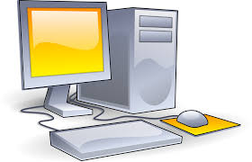
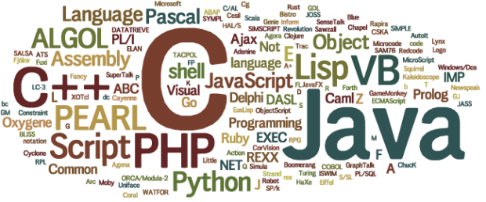
Week 4: History and Types of Computers and Programming
Week 4 provides history and context of programming ecosystems
Notes:
Hardware: the part of a computer you can kick. It's the stuff you have to buy, either up front at the Microsoft/Apple store or through the inflated prices of your smartphone plan that gave you the phone for “free”.
Q: How many programmers does it take to change a light bulb? A: None. It’s a hardware problem.
Q: How many hardware engineers does it take to change a light bulb? A: None. They’ll fix it in software.
Software: the part of a computer that kicks the hardware from the inside.
stuff that comes with the hardware (the operating system) which runs other stuff (application software, now just called “apps”) created (programmed) by people out of the goodness of their hearts (open source).
Software is like a sentence, a paragraph, a story, a novel. They all have a beginning, middle, and end. They are all created in a language. Like human languages, software languages evolved in different environments for different purposes.
BADware: see http://www.pcmag.com/encyclopedia/term/54210/wares
FATWARE: inefficient software with a BIG footprint; it tends to take over most of the CPU cycles, memory, and I/O bandwidth. Ever expanding computer code sizes and complexities in an application as new versions become available. Soon to pig out your computer, requiring an expensive upgrade. Adobe is a notable offender.
BLOATWARE: Applications that become overloaded with features that overwhelm computer memory and your memory. Sometimes called FeatureBloat. MS-Word may have been the application that spawned this term.
CRAPware (also called BLOATWARE): all the junk that comes with a Lenovo PC. Microsoft sells Signature Edition PCs with just the OS. VAPORWARE: Software (and sometimes hardware) that is announced by a company, but has not yet been (and may never be) released. RANSOMWARE: Code which, when encountered takes over your computer and locks up the files with the demand for money to release the data.
MALware and SPYware: watches what you do on your computer. Used for advertisement targeting and identity/credential theft.
C is to program microchips/ microcontrollers or make drivers. Low level programming, close to the hardware, small memory and processing footprint. UNIX was rewritten in C in 1972. Database systems were originally written in C. C is still alive and well in the Linux kernel and in small devices using firmware.
C++ useful for high performance real-time application (operating systems are written in C++, high performance video games) - Hard to work with (manual memory management – necessary for OS programming) + High portability (run on almost every kind of device)
- Runtime footprint higher than C
- improved software quality and reduced maintenance effort over C “C++ code is less complex, less prone to errors and requires less effort to maintain” (Bhattacharya and Neamtiu, 2011. “Assessing Programming Language Impact on Development and Maintenance: A Study on C and C++”)

Slide 8
Week 4: History and Types of Computers and Programming
Computers: electronic devices for storing and processing data according to instructions in a program
Users interact with Applications – high-level software.
Applications interact with an Operating System (OS)
OS: low-level software interacts with Hardware
Hardware: physical devices of a computer system controlled by an OS.

Slide 9
Week 4: Programming & Programming Languages
A computer program is a list of instructions telling a computer system (the 'machine') what to do.
Computer programming (now just 'programming') is a process that leads from the formulation of a problem to an executable solution.
Source code is a human readable programming language compiled into software that is now executable code. eLearning Tutorials
eLearning Tutorials Login needs your Seneca credentials and a LinkedIn account since LinkedIn bought Lynda e.g. Programming-Foundations-tutorials
Notes:
SICT does not have a course in Python. Why? Because, by the end of your program, Python will be very easy to learn on your own. We don't want to waste your time.
The terms program and software are often used interchangeably and potentially incorrectly.
See https://en.wikipedia.org/wiki/Software
and https://en.wikipedia.org/wiki/Computer_program
However, See https://teamtreehouse.com/community/the-difference-between-application-program-software
Program- A set of instructions telling a computer what to do.
Software- programs and other operating information used by a computer. Software can be made up of more than one program. All-encompassing term that is often used in contrast to hardware (the tangible parts of a computer)
Application- A program or group of programs designed for the end user. Application software (or "app") is a set of computer programs designed to permit the user to perform a group of coordinated functions, tasks, or activities. Application software is dependent on system software in order to run.
"All applications are programs, but a program is not necessarily an application. For example, there are always lots of programs running on the background of an operating system, but since they weren't developed for the end-user, they are not applications. On the other hand, Windows Media Player and Firefox, for example, are applications. They have a Graphical User Interface." - https://www.quora.com/What-is-the-difference-between-an-app-and-a-program

Slide 10
Week 5: Number Systems and Programming
There are 10 types of people in the world:
Notes:
There are 10 types of people in the world:
01 those who know ternary,
10 those who don't,
11 and those who thought this was going to be a binary joke

Slide 11
Week 5: Number Systems and Programming
There are 10 types of people in the world:
01 those who know binary
10 and the other nine

Slide 12
Week 5: Number Systems and Programming
10 types of people:
01 those who know ternary,
10 those who don't,
02 those who thought this was a binary joke
Notes:
There are 10 types of people in the world:
01 those who know ternary,
10 those who don't,
11 and those who thought this was going to be a binary joke

Slide 13
Number Systems
A number system represents numeric values.
Ten fingers: base-10 decimal, positional notation
Ones, Tens, Hundreds, Thousands, …
ICT uses base-2 binary and base-16 hexadecimal
Ones, Twos, Fours, Eights, … Ones, Sixteens, 256s, …
Decimal vs Binary – significant implications for programmers
Notes:
Binary number systems are for computers’ internal representation of numbers.
Decimal symbols output by computers are for humans.
The two are very different as far as programmers are concerned.
Many early computers 1945-1960 used DECIMAL arithmetic logic units (ALU). By the end of the 1960s, all computers were using binary ALUs because they were cheaper and faster than decimal ALUs. Programmers had to suck it up and started thinking, “Will this integer ever be bigger than 37,767?” and “What do I do when I need a value between zero and one? There is no 0.5 in binary!” Floating point numbers estimate decimal place values – very bad for financial applications. Integers are accurate but they don't have fractional decimal places. We'll tell you what to do in Week 5.

Slide 14
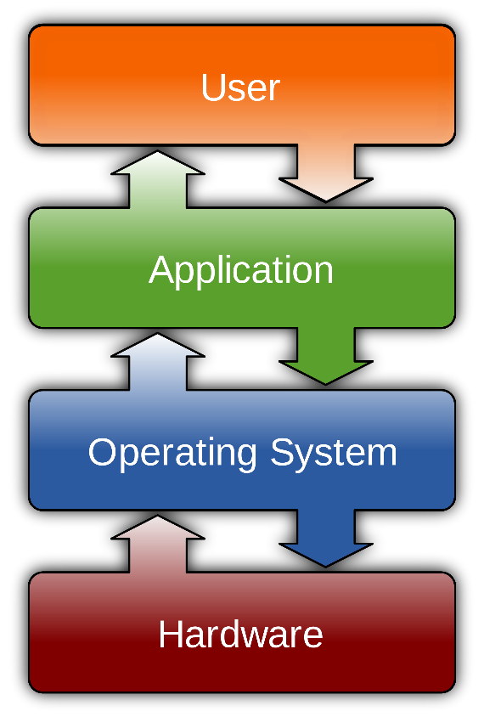
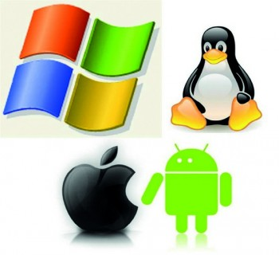
Week 6 - Hardware + Software = Platform System Terminology and Design
Notes:
Where does your program run? Nope, nope, nope. It runs on the User – that’s where the meaning is, the purpose, the benefit. Otherwise your program is just compiled code run by an OS on a chunk of silicon. Programs are for solving people's problems, not for chewing up CPU cycles.
When does a music become music? When it is written down in a score? Notes written on a staff are not much different from programming source code. A program run on a computer is similar to a musical score being played on an instrument. Neither becomes meaningful until people experience it.

Slide 15
Week 6 - Software Development: Platforms, SDLC, Environments, Version Control, APIs
System programming is developing software that interacts directly with the computer system itself.
Software design principles: architecture of Operating Systems that makes programming easier and safer.
Operating System (OS) is system software that supports a computer's basic functions, such as scheduling tasks, executing applications, and controlling memory, hardware, and peripheral devices.
Notes:
Week 4: about programming and systems
Week 6: the context and environment in which your programs run.

Slide 16
Software Version Control Systems
Version control, revision control or source control, is the management of changes to software configurations, documents, computer programs, OS software, web sites, and other collections of information.
Apache Subversion (SVN)
Git and GitHub (used in C programming course)
Notes:
https://en.wikipedia.org/wiki/List_of_version_control_software

Slide 17
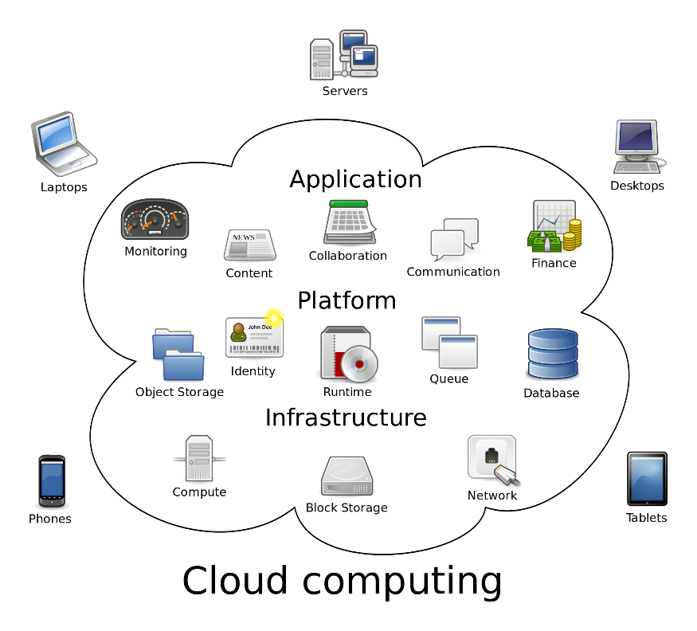
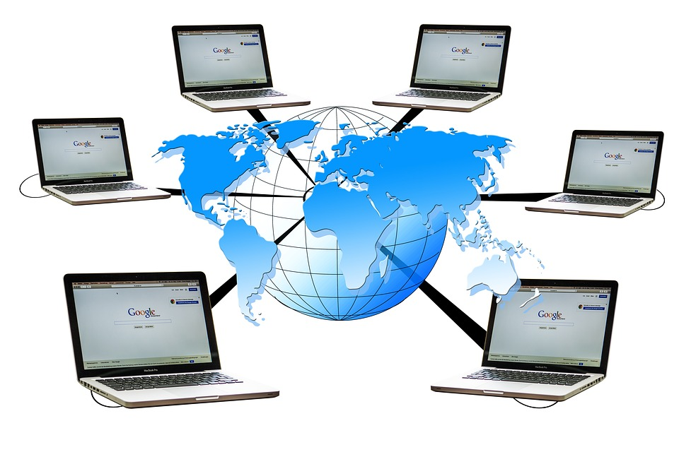
Week 7: Clients, Servers, Networks, and Clouds

Slide 18
Computer Networks
A computer network is a set of computers connected together for the purpose of sharing resources.
An intranet is an organization's local area network.
The Internet is a network of networks sharing information, resources, and services.
Metcalf's Law: the value of a network is proportional to the number of connected users squared (n²)
Notes:
https://en.wikipedia.org/wiki/Telecommunications_network
https://en.wikipedia.org/wiki/Computer_network
https://en.wikipedia.org/wiki/Intranet
https://en.wikipedia.org/wiki/Internet
https://en.wikipedia.org/wiki/Metcalfe%27s_law
The more users and devices connected in a network, the more valuable the network becomes – exponentially. https://en.wikipedia.org/wiki/Exponential_growth#Computer_science
Bob Metcalf helped pioneer the Internet starting in 1970. What has evolved into the standard for computer networking, Ethernet, was born in 1973 at PARC when Bob Metcalfe and David Boggs proposed a system of linking workstations, files, and printers together using a coaxial cable within a local area network. The benefit was that components could join or leave the network without disturbing data traffic.

Slide 19
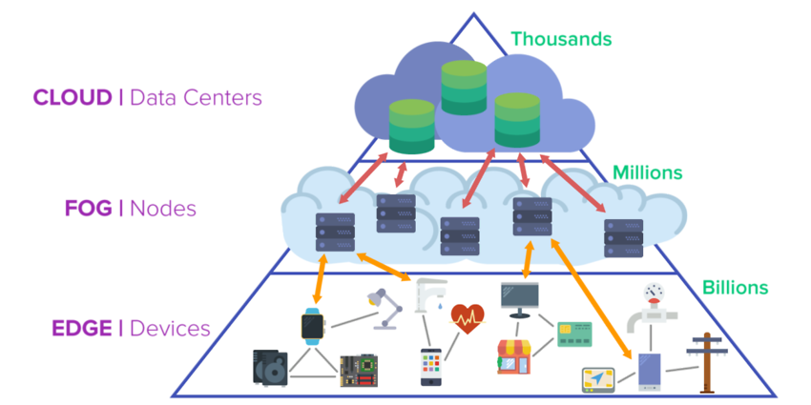
Cloud to Edge Computing
Notes:
5G WAN wireless will make EDGE computing very powerful. Already being used in manufacturing for real time shop floor control, e.g. controlling robots, quality control sensors.
Data transmission speeds will be 3 – 10 times faster than 4G.
5G will achieve 100 times more density of devices/vehicles that can use real-time data streaming. 5G has network separation capability. So, a logical network, which could encompass connected driving features, can be solely dedicated to autonomous driving. This means that only vehicles will be using that particular logical network, and so network performance, business modelling, pricing, etc. can be focused on vehicles’ needs. The latency can also be managed because there is only a specific kind of traffic. Your car won't crash because the kids in the minivan beside you are watching Netflix.
Latency is defined as the average time between the transmission of packet and the reception of an acknowledgment, effectively the time it takes for data from your device to reach its target.
Latency is very important for applications like gaming and real time autonomous driving, where response time can have an impact on the outcome when quick decisions can trigger a reaction to brake or avoid an obstacle in real time. Instead of cars avoiding each other, cars will be able to talk to each other, cars will get closer together and become cooperative vastly improving efficiency of road systems.
Gaming industry – enables mixed or extended reality (XR), augmented reality (AR), 360-degree videos, and virtual reality (VR)
Latency will be very low: between 1ms (millisecond, one thousandth of a second) and 10ms enabling "real time" processing. 4G is ~50ms. Latency between human eye and brain: ~10ms
High level summary of 5G
http://time.com/5594360/what-to-know-about-5g/
https://www.digitaltrends.com/mobile/5g-vs-4g/
https://medium.com/datadriveninvestor/is-5g-friend-or-foe-for-autonomous-vehicle-72ee70800031

Slide 20
Cloud Computing & File Sharing
Cloud and Edge Computing is
Magic
Using remote services to store, manage, process data, and run applications rather than on a local server.
eLearning Tutorials Login needs your Seneca credentials and a LinkedIn account since LinkedIn bought Lynda
Cloud Computing introductions
Notes:
Week 7: what happens when computing is not just about one program running on one system?
It is about the implications of all systems being connected to each other.
Cloud computing is possible because of reliable, affordable, fast communication networks, both wired and wireless.
https://softwareengineeringdaily.com/2018/09/14/edge-computing-and-the-future-of-the-cloud/

Slide 21
If someone from the 1950s suddenly appeared today, what would be the most difficult thing to explain to them?
Notes:
https://as.reddit.com/r/AskReddit/comments/15yaap/if_someone_from_the_1950s_suddenly_appeared_today/ (Fri Jan 4, 2013)
"If someone from the 1950s suddenly appeared today, what would be the most difficult thing to explain to them?"
Top rated answer:
I possess a device, in my pocket, that is capable of accessing the entirety of information known to man. …
I use it to look at pictures of cats and get in arguments with strangers. – Phil Veal
https://twitter.com/pjveal/status/287995557753004033?lang=en
They would ask,
"Are there a lot of crazy people now? Many people are walking down the street talking to themselves."
"Are there a lot more religious people now? I see many people walking silently and slowly down the street with their head bowed and hands together holding miniature black books; they appear to be praying; are they on some kind of pilgrimage?"
….praying not to walk into traffic.

Slide 22
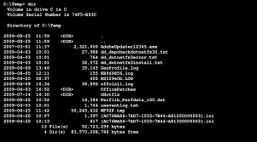

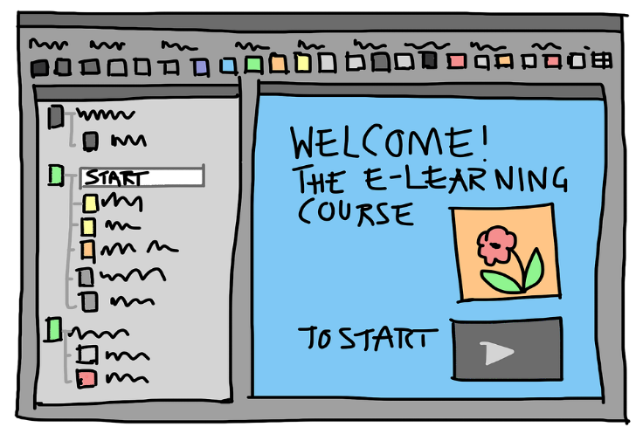
Week 8: User Interfaces, Time Management and Powershell

Slide 23
CLI – Command Line Interface or PTUI – Plain Text User Interface
Notes:
PTUI is a joke. It is pronounced “p-too-ee” as in the cartoons when a character spits.
What a clean and clear, uncluttered, pure, simple, straightforward, uncomplicated, streamlined, efficient, elegant User Interface! It is all those things but it is not particularly useful unless you are an expert with a very good memory.

Slide 24
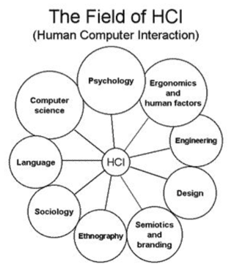
HCI Human Computer Interaction
CLI to TUI to GUI to UX
Notes:
Is your GUI “an impenetrable confusion of forms, colours and noises”? See Deiter Rams’s ten principles for good design https://www.vitsoe.com/us/about/good-design
Good design: makes a product useful and understandable, is innovative, unobtrusive, honest, long-lasting, thorough, aesthetic, and is as little design as possible.
Bells and whistles, features, functions, cool screen widgets, and clever code are the hallmarks of programmers’ egos…done to impress themselves and other programmers. Users suffer the consequences. E.g. make clickable links obvious, like the simple visual affordance of the underline in the good old days. Hiding it, because you are clever enough to know how, turns the major advantage of a GUI—its visual nature—into something worse than a command line interface: it becomes a tedious pixel hunt for features. An empty command line is not particularly user-friendly but at least there is a way to discover its features with manuals and help text. A GUI's hidden features, perhaps to avoid a cluttered interface, are knowable only upon mouse-over. A standard 1920 x 1080 screen contains over 2 million pixels. That's a lot of mousing.
In general UX is concerned with how people feel about a system.
value (is it useful?), usability (‘is it easy to use?’), adoptability (is it easy to start using?’), and desirability (is it fun and engaging?’). (Guo, 2012. see http://www.uxmatters.com/mt/archives/2012/04/more-than-usability-the-four-elements-of-user-experience-part-i.php)
https://www.explainxkcd.com/wiki/index.php/2141:_UI_vs_UX
https://www.iso.org/standard/52075.html
ISO (International Standards Organization) 9241-210:2010 provides requirements and recommendations for human-centred design principles and activities throughout the life cycle of computer-based interactive systems. It is intended to be used by those managing design processes, and is concerned with ways in which both hardware and software components of interactive systems can enhance human–system interaction.
https://en.wikipedia.org/wiki/User_experience
https://en.wikipedia.org/wiki/Human%E2%80%93computer_interaction
https://senecacollege-primo.hosted.exlibrisgroup.com/primo-explore/fulldisplay?docid=TN_loughborough2134/15600&context=PC&vid=01SENC&search_scope=default_scope&tab=default_tab&lang=en_US
Using human factors standards to support user experience and agile design
Abstract: The ISO 9241-210 standard provides a framework for human-centred design (HCD) activities comprising the four stages: context of use, specification of user and organisational requirements, design solutions, and evaluation against requirements. Other parts of the 9241 standard cover user interface design and usability. This paper uses the HCD framework to emphasise user experience (UX) design and methods used to help create good user experiences. It also relates the framework to an agile software development environment. It is concluded that the flexible and iterative nature of ISO 9241-210 makes it a good basis for both user experience design and an agile development process.

Slide 25
HCI: Human Computer Interaction
CLI: Command Line Interface uses textual keyboard input and character output to control an OS
TUI: Textual User Interface – 24 x 80 screen. Vi & Vim
GUI: Graphical User Interface uses graphical elements such as windows, icons, and menus. GUI elements are manipulated with pointing devices (e.g. mouse) and/or touch in addition to keyboard input.
User eXperience - "look and feel". Is it...useful? easy to start using? easy to keep using?
Notes:
Human Computer Interaction: what you can see and touch. Known as the "look and feel". HCI is the interaction between user and software using devices such as screens, keyboards, and mice; also voice recognition and many other modalities.
Text screens, by default, are 80 characters wide, likely because punch cards had 80 columns.
Advantages and dangers of different User Interfaces.

Slide 26
Time Management
Time is what keeps everything
from happening at once.
Notes:
"Time is what keeps everything from happening at once." – Ray Cummings' 1922 science fiction novel The Girl in the Golden Atom, Ch. V:
The Problem with Time is you can't…
manage Time anymore than you can manage Cats
have Time anymore than you can have Gravity
make Time anymore than you can make Sunshine
find Time anymore than you can find your Keys
run out of Time…maybe not today, maybe not tomorrow, but soon.
The secret of Time Management:
Time is not something you have or don't have.
Time is a choice you make.
…more in Week 8
If you think you don't have time to sleep, you've got it backwards. You don't have enough time because you don't get enough sleep. There is research on this.
"Students at risk for sleep disorders were overrepresented among students in academic jeopardy (GPA < 2.0). Conclusions: Many college students are at risk for sleep disorders, and those at risk may also be at risk for academic failure." 'Catching up on sleep on weekends/days off makes the sleep deprivation/disorder problem worse.
Jane F. Gaultney PhD (2010) The Prevalence of Sleep Disorders in College Students: Impact on Academic Performance, Journal of American College Health, 59:2, 91-97, DOI: 10.1080/07448481.2010.483708
Research found that students who had more regular sleep patterns had better average school grades. When it came to the average sleep duration, there was no significant difference between students with irregular sleep patterns and most regular sleepers. [so getting the same number of hours of sleep each week is not as important as getting the same number of hours each day] Andrew J. K. Phillips, PhD, Biophysicist at the Division of Sleep and Circadian Disorders, Brigham and Women’s Hospital, 2017. https://www.studyinternational.com/news/the-impact-of-sleep-on-academic-performance/
Sleep is an important biological necessity, College students often have erratic sleep schedules, poor sleep hygiene and poor sleep quality, which might affect their performance and cognitive functions. 143 (95.3%) students obtained less than the recommended 7-8 hours of sleep. Conclusion: Academic performance and cognitive functions [memory, attention, concentration] of students who were sleep deprived was poor.
[Better Sleep = better grades and better brains] Rose, Sumi. (2018). Effect of Sleep Deprivation on the Academic Performance and Cognitive Functions among the College Students: A Cross Sectional Study. 14.

Slide 27
Time Management
Time is what keeps everything
from happening at once.
Time isn't something you have,
it's a choice you make.
Notes:
"Time is what keeps everything from happening at once." – Ray Cummings' 1922 science fiction novel The Girl in the Golden Atom, Ch. V:
The Problem with Time is you can't…
manage Time anymore than you can manage Cats
have Time anymore than you can have Gravity
make Time anymore than you can make Sunshine
find Time anymore than you can find your Keys
run out of Time…maybe not today, maybe not tomorrow, but soon.
The secret of Time Management:
Time is not something you have or don't have.
Time is a choice you make.
…more in Week 8
If you think you don't have time to sleep, you've got it backwards. You don't have enough time because you don't get enough sleep. There is research on this.
"Students at risk for sleep disorders were overrepresented among students in academic jeopardy (GPA < 2.0). Conclusions: Many college students are at risk for sleep disorders, and those at risk may also be at risk for academic failure." 'Catching up on sleep on weekends/days off makes the sleep deprivation/disorder problem worse.
Jane F. Gaultney PhD (2010) The Prevalence of Sleep Disorders in College Students: Impact on Academic Performance, Journal of American College Health, 59:2, 91-97, DOI: 10.1080/07448481.2010.483708
Research found that students who had more regular sleep patterns had better average school grades. When it came to the average sleep duration, there was no significant difference between students with irregular sleep patterns and most regular sleepers. [so getting the same number of hours of sleep each week is not as important as getting the same number of hours each day] Andrew J. K. Phillips, PhD, Biophysicist at the Division of Sleep and Circadian Disorders, Brigham and Women’s Hospital, 2017. https://www.studyinternational.com/news/the-impact-of-sleep-on-academic-performance/
Sleep is an important biological necessity, College students often have erratic sleep schedules, poor sleep hygiene and poor sleep quality, which might affect their performance and cognitive functions. 143 (95.3%) students obtained less than the recommended 7-8 hours of sleep. Conclusion: Academic performance and cognitive functions [memory, attention, concentration] of students who were sleep deprived was poor.
[Better Sleep = better grades and better brains] Rose, Sumi. (2018). Effect of Sleep Deprivation on the Academic Performance and Cognitive Functions among the College Students: A Cross Sectional Study. 14.

Slide 28


Week 9 - File Compression and Backup

Slide 29
File Compression & Backup
File compression is a process of packaging a file (or files) to use less disk space or bandwidth.
Backed up is two copies in geographically separate locations on independent systems.
Methods and disciplines of professional backup.
The punchline: Backup doesn't matter. Only Restore matters.
Notes:
File compression is a design choice you have to make: will all those bits get to the user's device before the user runs out of patience (or data plan)?
iTunes was successful partially because mp3 files were small enough to transmit and store on an iPhone but sounded 'good enough' under the circumstances in which they were listened to.
It is not completely backed up unless you have two copies in geographically separate locations on independent systems. And that doesn't include the original file on your phone, tablet, or PC.
N.B. two way synchronization of your PC's files with a cloud service makes your system interdependent with the cloud.
Restoring from backup is disaster recovery…we hope we never have to use our backup.

Slide 30
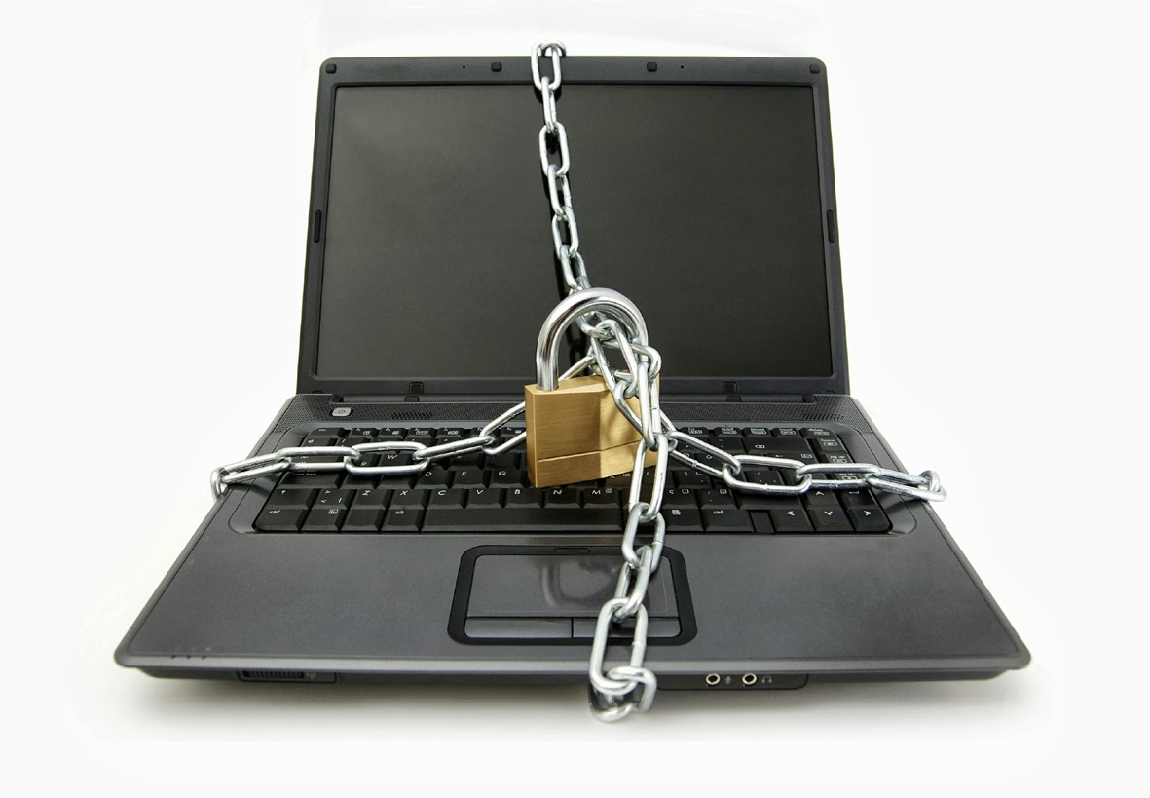
Week 10: Authentication and Security

Slide 31
Authentication & Authorization
Authentication verifies a user's identity e.g. with email@address and password
Authorization gives a user (or a program) permission to do or to access something. e.g. open or change a file, read a directory
Password issues, problems, and safe storage
Security issues that might keep you up at night
Notes:
We will cover how passwords should be properly stored on the servers hosting the web applications you will create.

Slide 32
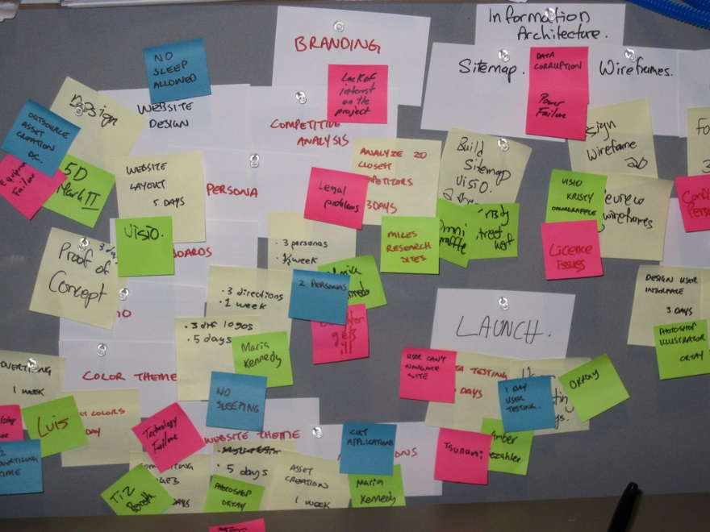

Week 11 - IT Projects, IT Jobs, and Project Management

Slide 33
IT Projects, Jobs, Project Management
Systems Analysis – What's the problem?
System Development – What's the solution?
Programming or "Implementation" is part of this
Project Management – Make it happen!
the discipline of initiating, planning, executing, controlling, and closing the work of a team

Slide 34



Week 12: Software Licensing, Intellectual Property, Privacy

Slide 35
Closed vs Open Source, Licensing
A software license is a legal instrument governing the use or redistribution of both Close and Open software.
Closed source (or proprietary software) means the source code is copyrighted, not published or shared.
Only compiled software is distributed under restrictive licensing e.g. IBM, Apple, Windows operating systems
Open-source software's source code is shared and developed in a collaborative public manner with copyleft or permissive licensing.
Notes:
Knowing the differences in licensing is important, especially for start-up companies.
It can mean the difference between you buying a bigger, nicer house or losing the house you have.

Slide 36
Intellectual Property and Related Rights, Data Privacy in IT
Intellectual Property is a work or invention that is the result of creativity to which one has rights, and for which one may apply for a patent (new idea), copyright (expression of an idea), or trademark (icon of a unique concept, technology, or company).
Data Privacy: data belongs to the person, not the organization that collects it.
Notes:
Organizations which collect information from people are responsible for the data's proper use and security.
Unless you use Facebook, Instagram, or other social media services to which you agree to give them all rights to your data.
Canadian Intellectual Property Office (CIPO)
http://www.ic.gc.ca/eic/site/cipointernet-internetopic.nsf/eng/wr03915.html?Open&wt_src=cipo-cpyrght-main&wt_cxt=apply

Slide 37
Preview of the weeks to come
Week 4: History and Types of Computers and Programming
Week 5: Number Systems and Programming, Versioning
Week 6: Hardware + Software = Platform
Week 7: Clients, Servers, Networks, and Clouds
Week 8: User Interfaces, Time Management and Powershell
Week 9: File Compression and Backup
Week 10: Authentication and Security
Week 11: Project Management, final project intro
Week 12: Software Licensing, Intellectual Property, Privacy
Week 13: Final Project

